Slide 1
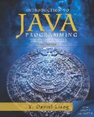
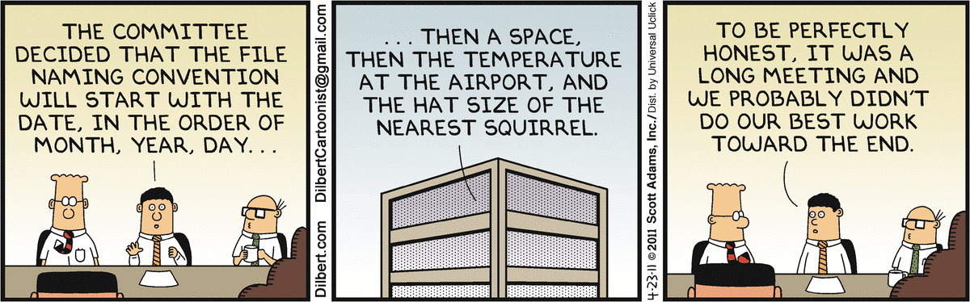
Introduction to Computer Programming II
Week 03
Text File I/O
[1]

Slide 2
Motivation
Data are stored in files
Some of those files are text files
Your code needs to read/write such files

Slide 3
Solution
Java provides classes for manipulating files.
Notes:
yay!

Slide 4
Strategy
Open
Read/Write
Close

Slide 5
A Stream
In Java, files have no built-in format.
These files are called streams or filestreams.

Slide 6
Two Types of Files
Text
Human-readable
Usually divided into “lines”
Binary
Not human-readable
Has no assumed format
Both types are streams

Slide 7
We Read the Two Types of Files Differently
Java provides classes for both types of files.

Slide 8
The Text File Trick
A “line” in a text file is delimited by a newline character.
Java has special classes for this.

Slide 9
The FileReader Class
Used to open a text file for reading (duh)
Throws an exception if the open fails

Slide 10
The FileReader Class
FileReader myFileReader;// in java.io
try {
myFileReader = new FileReader(“foo.txt”);
} catch(Exception ex) {
System.out.println(“Error opening file: " + ex.getLocalizedMessage());
}
Notes:
Watch the quote marks if you plan to copy/paste into Eclipse…

Slide 11
Warning
Watch the backslashes in quoted strings
What is “\n” ?
Why can’t you open this file:
“c:\temp\foo\newData.txt”
Notes:
Java expands the escape codes, not Windows.

Slide 12
The BufferedReader Class
BufferedReader b = null;
FileReader myFileReader;// in java.io
try {
//Attempt to open the file for reading. This could go wrong in so many ways...
myFileReader = new FileReader(fileName);
// Instantiate an object that will read a file through a buffer.
b = new BufferedReader(myFileReader);
} catch(Exception ex) {
System.out.println("Demo.OpenTextFile(): Error opening file: " + ex.getLocalizedMessage());
}
Notes:
A BufferedReader object requires a FileReader object

Slide 13
Techniques
What is a ‘record‘ in a text file?
Open a text file, loop through all the ‘records’
Do something to each ‘record’

Slide 14
Techniques, cont’d
Open a text file, loop through all the ‘records’
Copy to another text file.

Slide 15
Try it…
Create an empty binary file.
Write an integer to the file.
Close the file
Analyze the contents with a binary editor.
[1]

Slide 16
References
[1] Search.Dilbert.com

